Slide 1

Fundamentals of web design
Mustafa & Sultans Cuisine
Mustafa Deeb 2022112227– Software Engineer
Sultan Al Mutairi 202211219 – Network and Security Engineer

Slide 2
About the project
My project is a Restaurant website that sells different dishes and plates.
It has a home page, About Me Page, Cart, Contact Us, two different Categories of food, and Beverages; Main Dishes, Deserts, Beverages

Slide 3
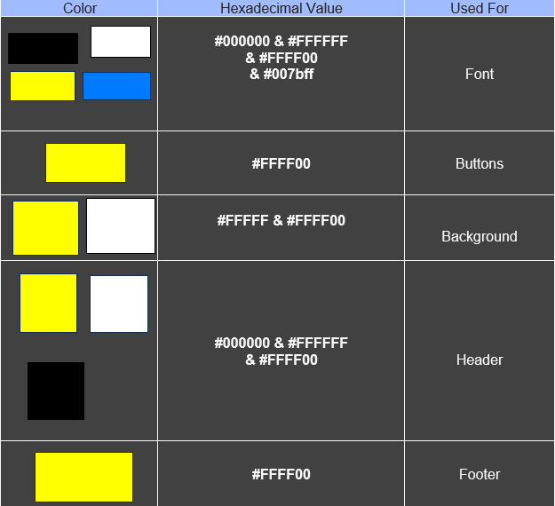
COLOR SCHEME

Slide 4
fonts
The fonts mainly used are Satisfy Cursive, Poppins Sans-Serif

Slide 5
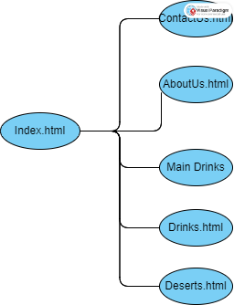
Page Hierarchy

Slide 6
pages
Index
Main Dishes
Deserts
Drinks
About Us
Contact Us

Slide 7
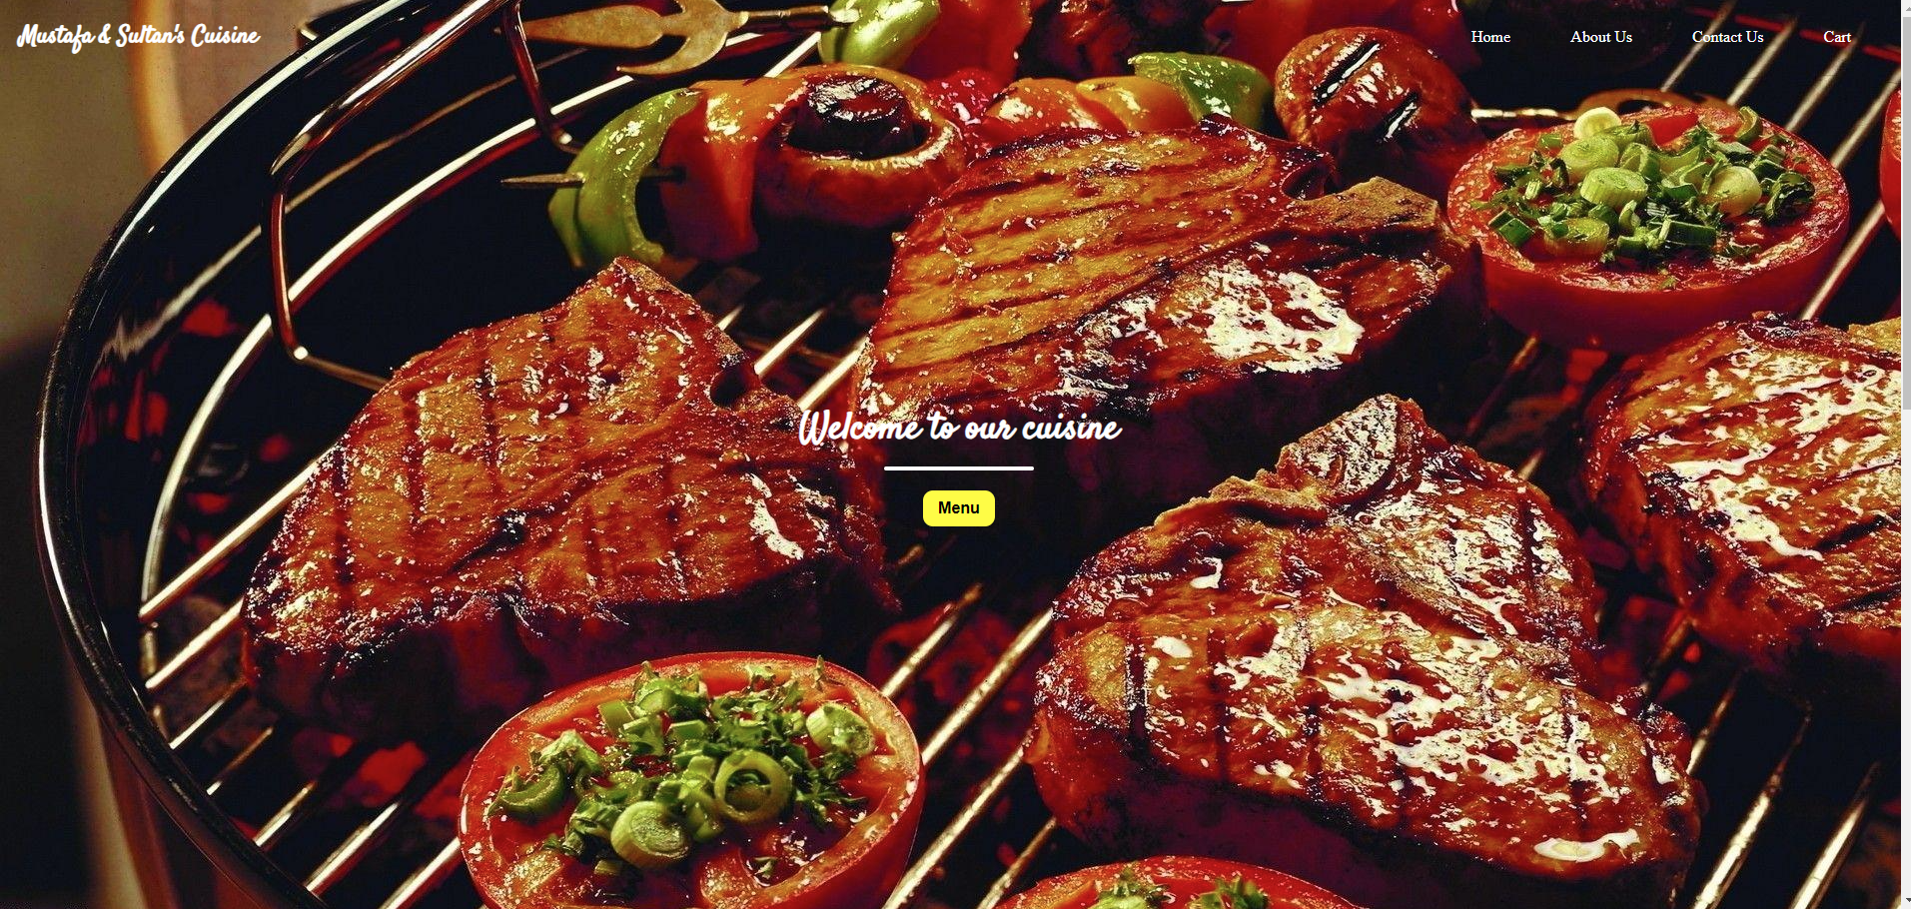
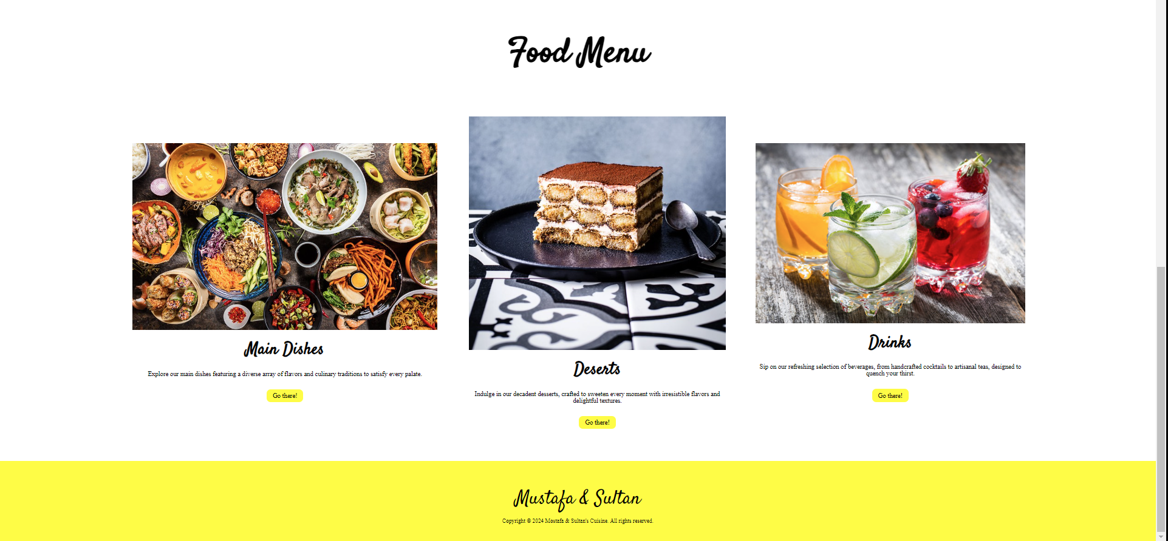
Home
Home page that has a picture, giving you an overall feel of what’s to come, and greeted with “ Welcome to our Cuisine “ and Menu button that scrolls down to the Menu Part.

Slide 8
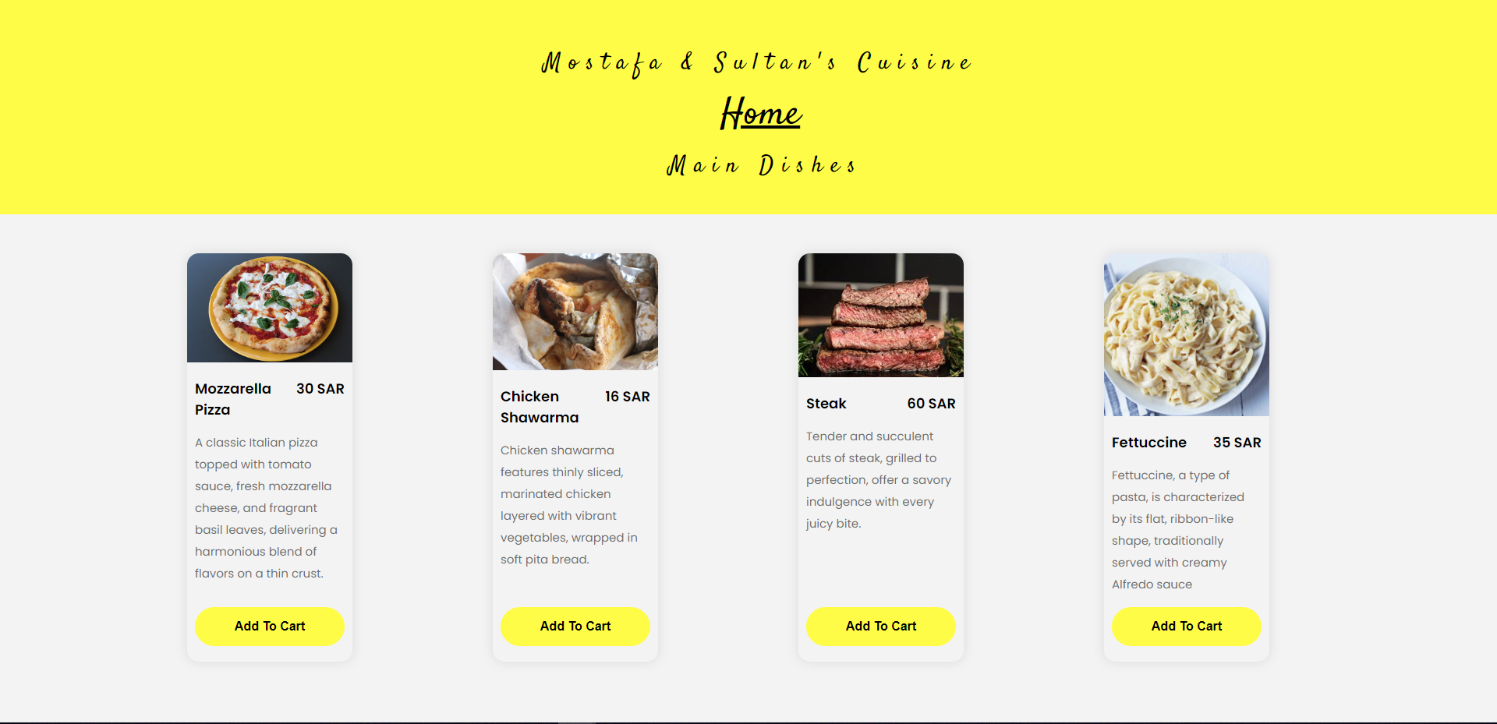
Main dishes
Main dishes category where it shows the main and important foods as part of any food experience.

Slide 9
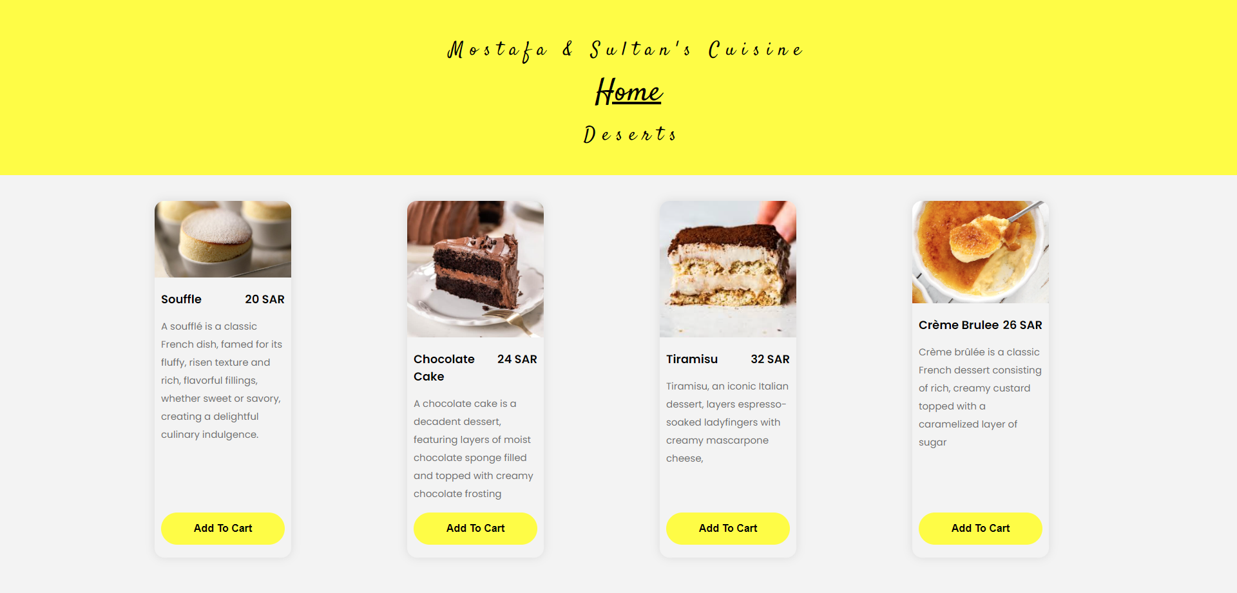
Deserts
Deserts category where it shows the deserts and the joyful ride you’ll go through after having your main dish.

Slide 10
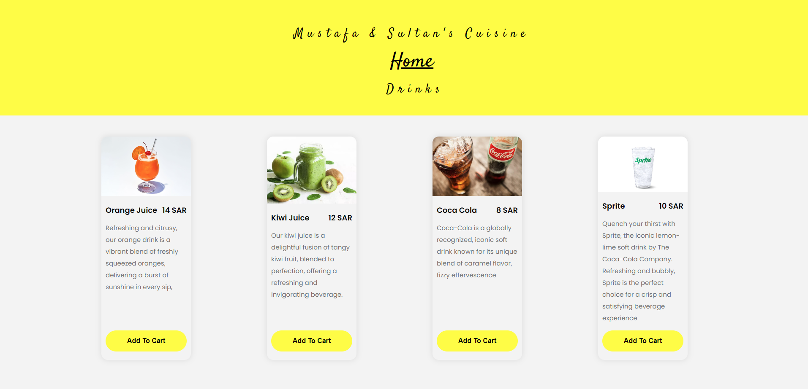
drinks
Drinks category where it shows refreshing beverages after a full-fledged meal.

Slide 11
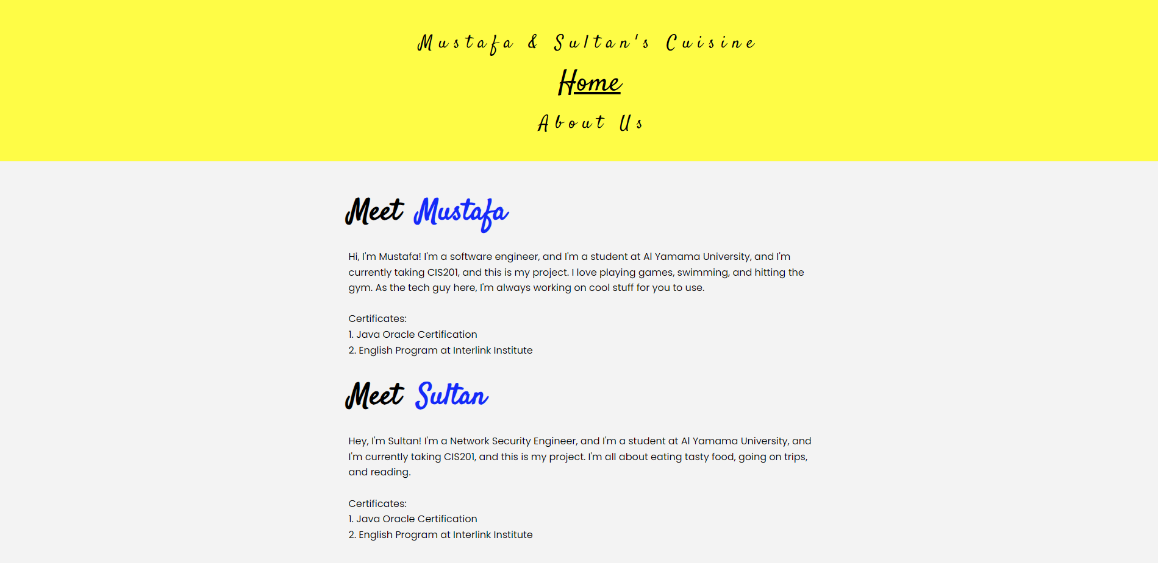
About us
It has all the important information about me and my colleague.

Slide 12
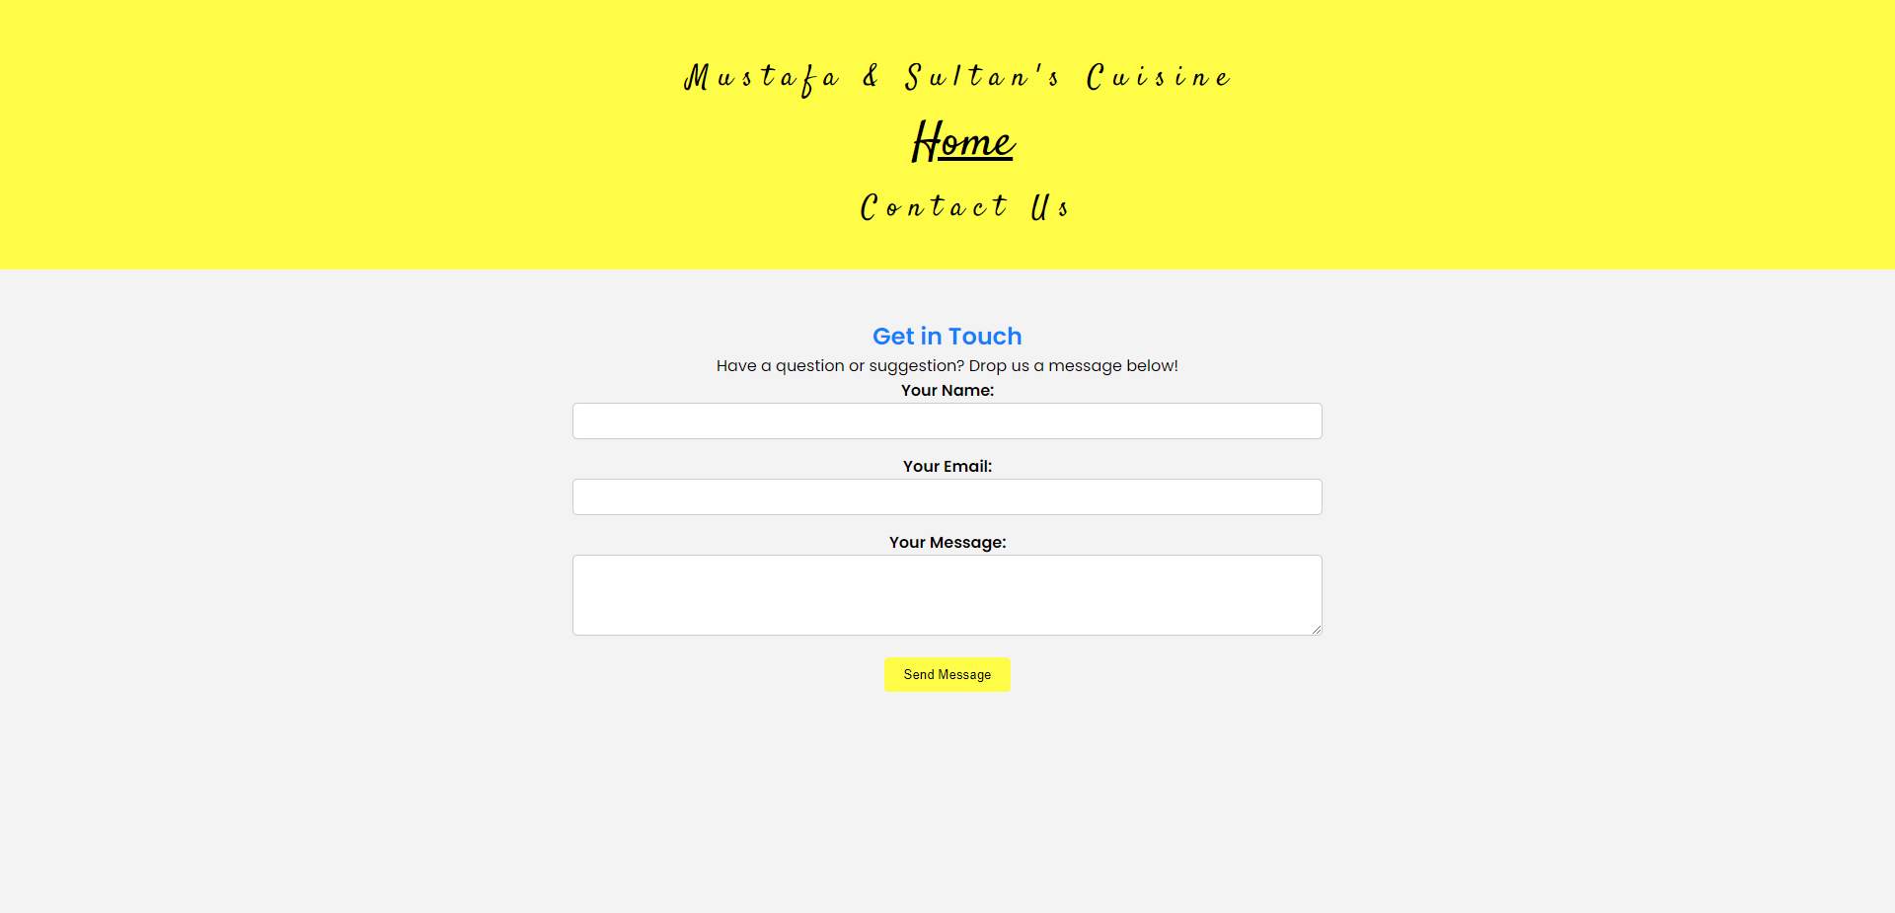
Contact us
This page gives you the option to deliver your recommendations or feedback to us.

Slide 13


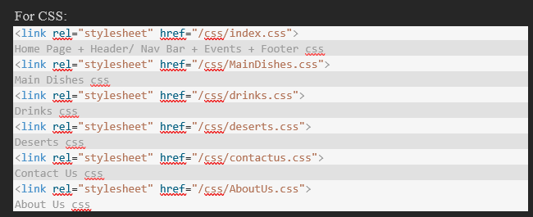
External links
For JS:
<script src="/JS/script.js"></script>
Scroll Down code to Events Section
<script>
function submitForm() {
alert('Your feedback has been sent.');
}
</script>

Slide 14
Thank you

